Slide 1


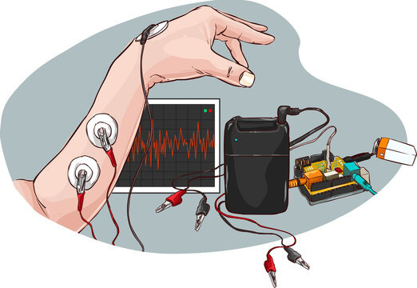

EN2091 - LABORATORY PRACTICE AND PROJECTS
STEM
EMG Device
Ananthakumar.T 220029T
Sivamynthan.N 220619D
Ahilakumaran.T 220017F Mathujan.S 220389U

Slide 2
Introduction
We have designed a EMG device to monitor muscle activity.
It can be used in rehabilitation, sports, and prosthetics.
Our goal is to support clinical rehabilitation, optimize athletic training, and enhance muscle performance through a user-friendly solution.

Slide 3
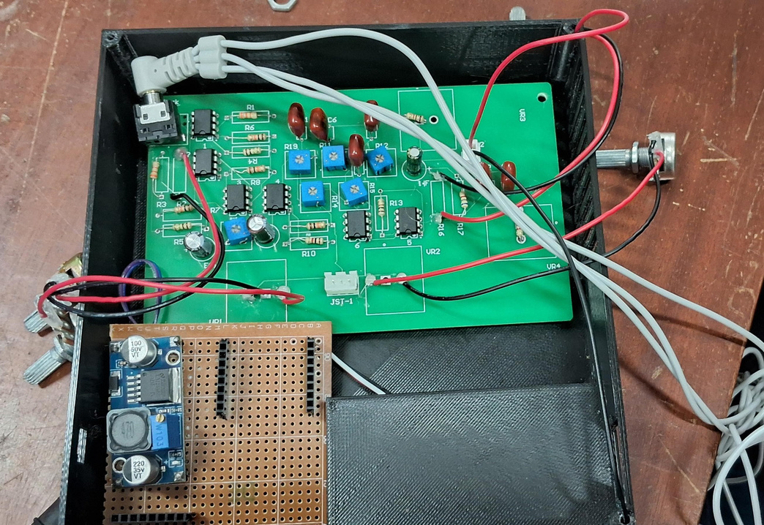
Product Overview
Traditional EMG devices are often expensive, bulky, and complex, limiting accessibility for muscle monitoring.
What we have designed is a cost-effective, portable EMG device.
It bridges the gap between high-cost systems and everyday needs.

Slide 4
Market Analysis
1. Target Audience
Healthcare Sector, Prosthetics & Assistive Tech, Sports & Fitness.
2. Market Demand
Increasing cases of stroke, spinal injuries, and muscular disorders.
Rising adoption of prosthetics in Sri Lanka.
Growing focus on sports injury prevention and recovery.
3. Competitive Edge
Current EMG devices are imported, expensive, and bulky.
Our device offers affordability, portability, and ease of use.

Slide 5
Market Analysis
4. Stakeholder Benefits
Patients: Affordable, at-home rehabilitation.
Physiotherapists & Doctors: Simplified diagnosis and monitoring.
Athletes: Optimized training & injury prevention.
5. Opportunities
Collaborations with rehab centers, sports clubs, and NGOs.
Education & awareness campaigns to demonstrate product value.

Slide 6
Design and Development
Background research
Studies highlight the need for affordable diagnostic tools in developing countries.
Advances in microcontrollers and signal processing enable cost-effective solutions.
Challenges
Only few research papers specified in this domain.
We have to convert what was applied to related domains and start fresh if none is available.

Slide 7
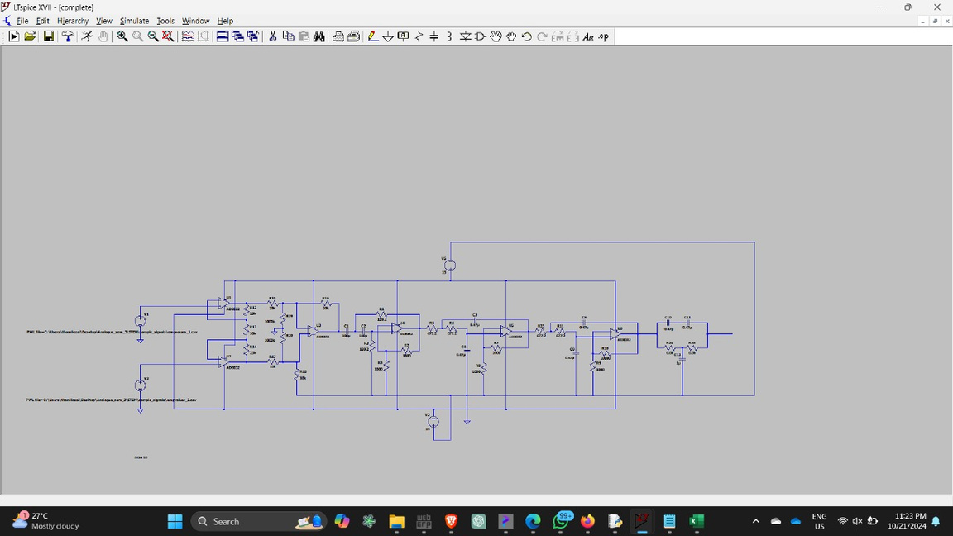
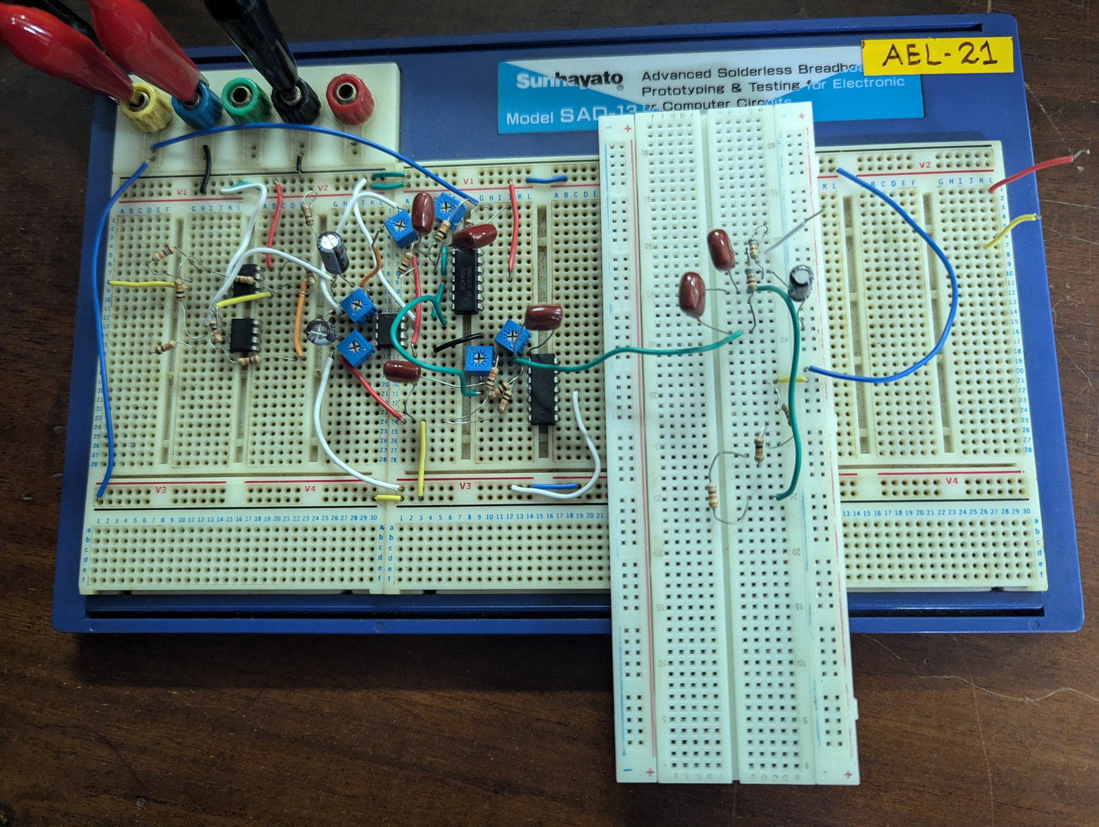
Design and Development
Prototyping
Initially the circuit was realized in LTSpice to ensure there are no defects
After finding necessary components, we tested out in protoboards

Slide 8
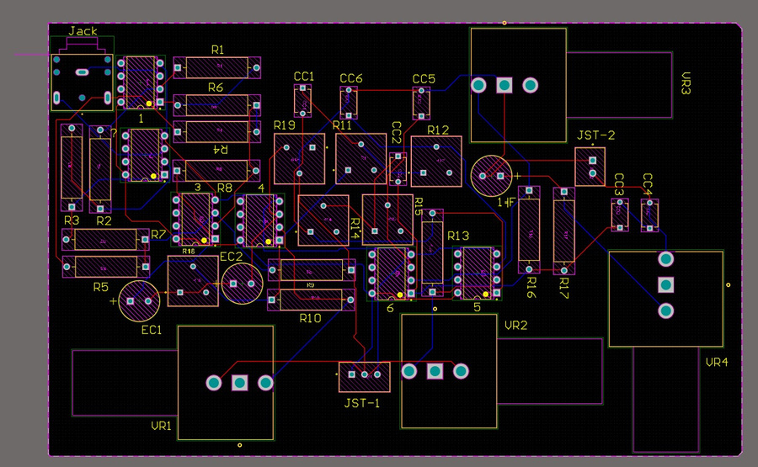
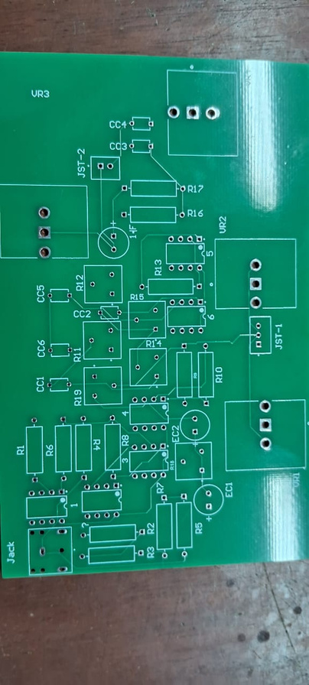
Design and Development
PCB Design
The final PCB was completed using Altium.
There was an additional PCB for the power circuit.

Slide 9
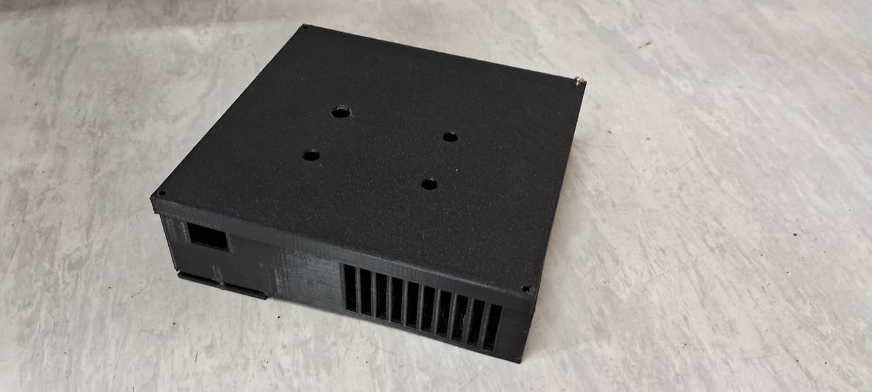
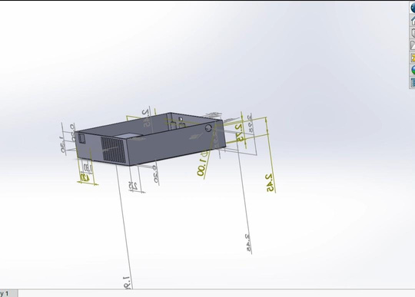
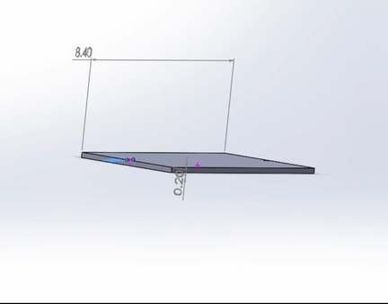
Design and Development
Enclosure and Finishing
After the device was complete, for the protective part we chose PLA enclosure which provided whether and physical protection

Slide 10
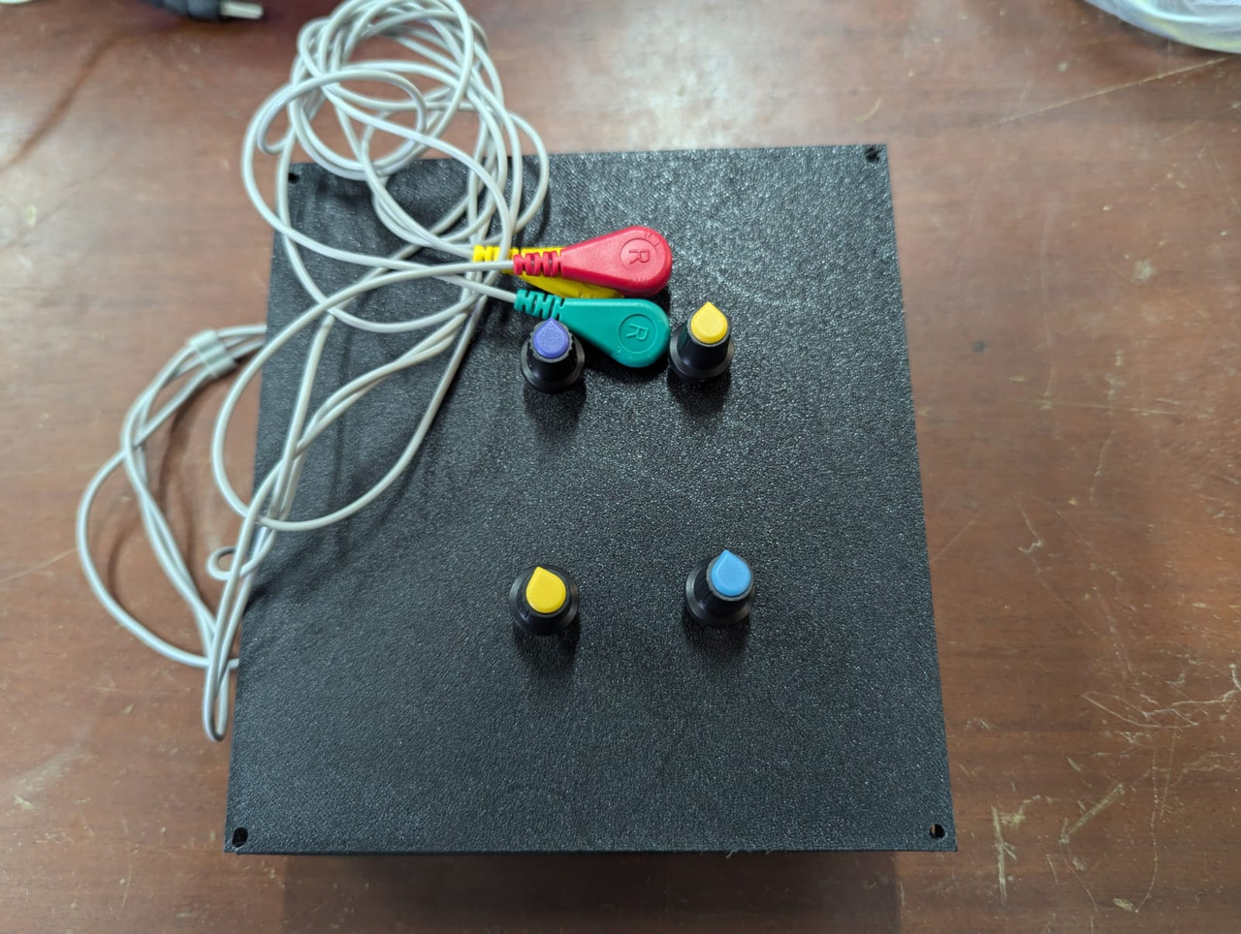
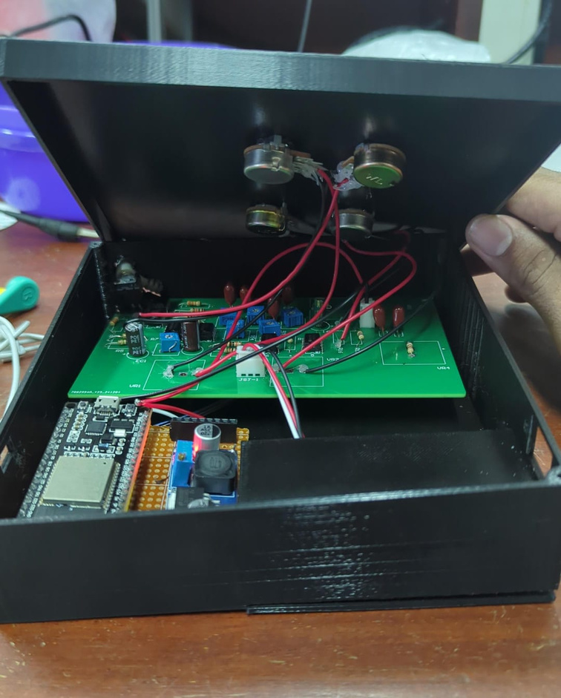
Design and Development

Slide 11
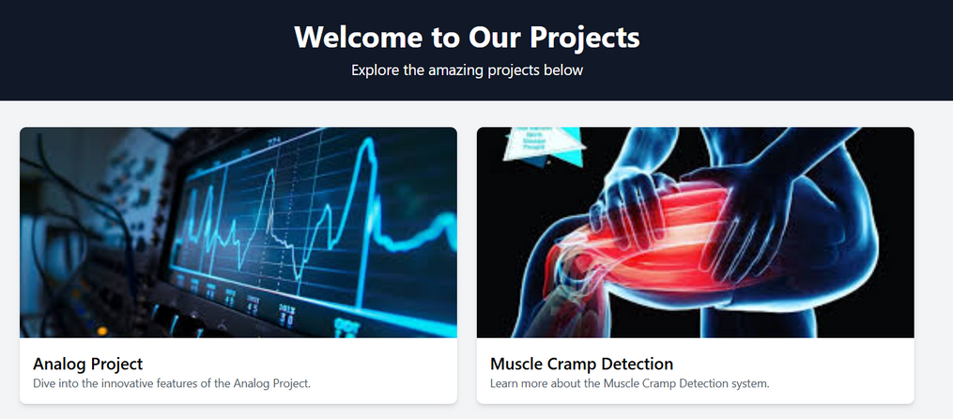
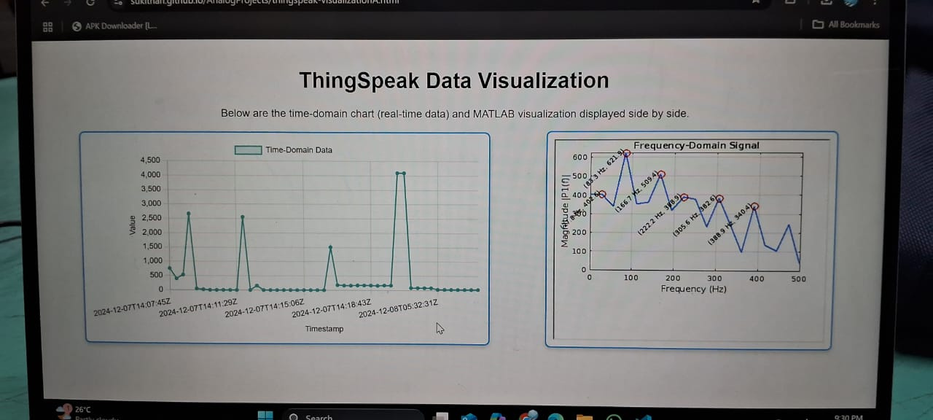
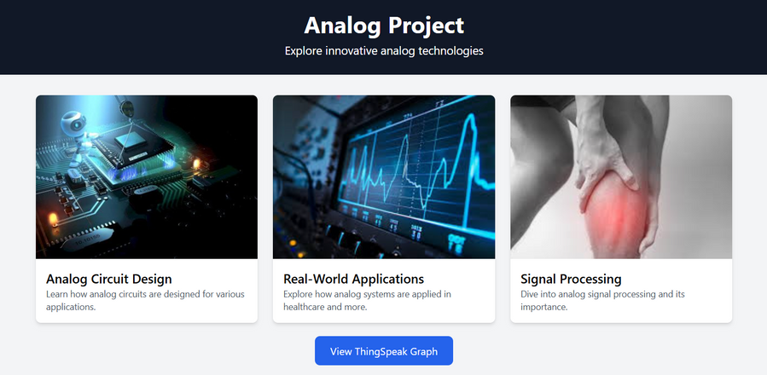
Design and Development
Webpage
The results of the EMG scan is readily availabe in our webpage within 15 seconds

Slide 12
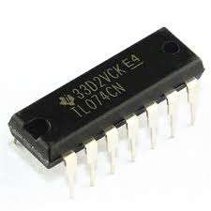
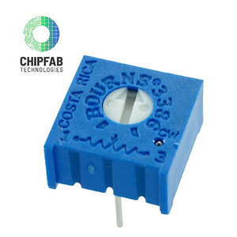
Technical Details
Components
TL074 operational amplifier
The TL074 is a quad low-noise operational amplifier (op-amp) widely used for signal processing applications. It is known for its low power consumption, low noise characteristics, and high input impedance, making it suitable for audio and instrumentation purposes.
Potentiometer
The 3006 Series Trimpot Potentiometer is a single-turn adjustable resistor ideal for precise resistance calibration in circuits. It offers a resistance range of 10Ω to 5MΩ with ±10% tolerance and a 0.5W power rating at 70°C. The compact design allows for top or side adjustment and operates across a temperature range of -55°C to +125°C, making it versatile for various applications.

Slide 13
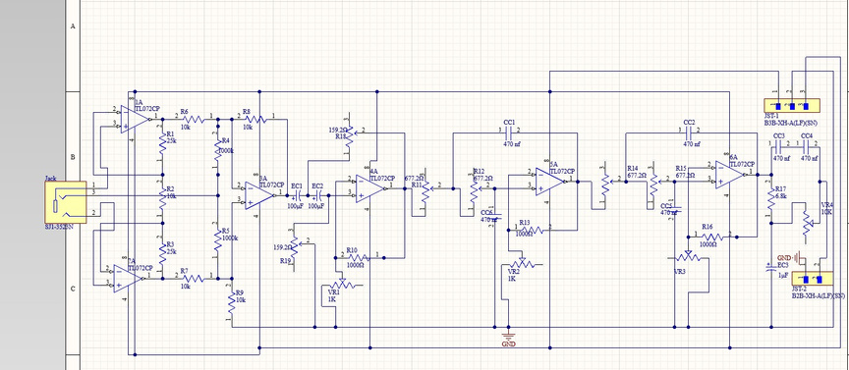
Technical Details
Circuit Diagram
LTSpice Schematic

Slide 14
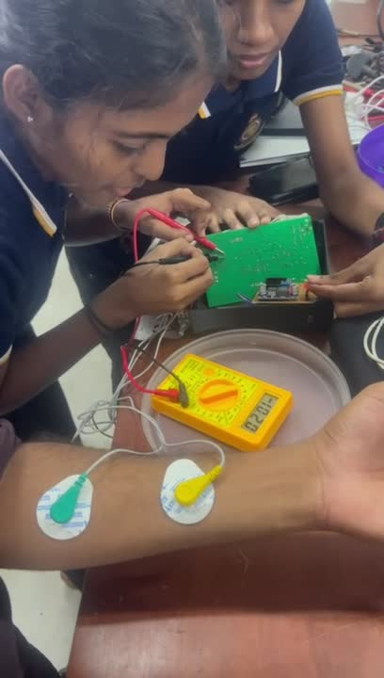
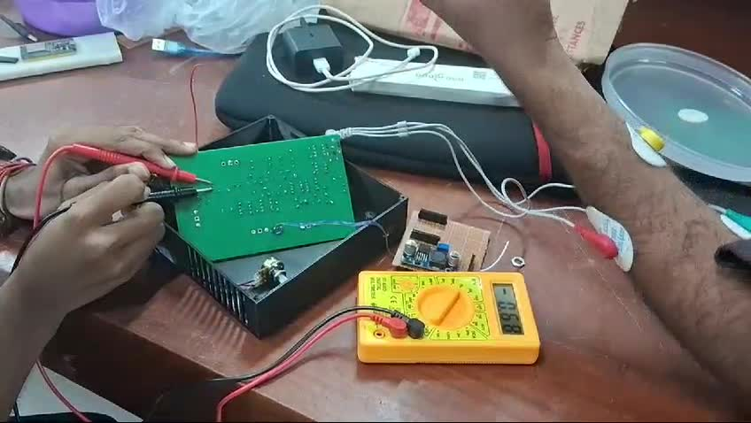
Demonstration
Captured when testing the input jack

Slide 15
Cost Analysis
1. Development Costs
Material Costs: Sensors, microcontroller, wires, casing, and battery – LKR 12,000.
Prototyping Costs: PCB fabrication and 3D printing – LKR 8,000.
Software Tools: Free development platforms – LKR 0.
Labor Costs: Team contribution (self-funded) – LKR 0.
2. Production Costs (Projected)
Bulk manufacturing cost per unit: LKR 6,000.
Assembly cost per unit: LKR 1,000.

Slide 16
Cost Analysis
3. Cost Comparison
Existing EMG devices: LKR 50,000 - 100,000.
Our device: Estimated retail price LKR 15,000.
4. Total Project Cost
Total expenses for development: LKR 20,000
5. Pricing Strategy
Affordable price to ensure accessibility while maintaining a profit margin

Slide 17
Limitations and Future Enhancements
Current Limitations
Performance may vary depending on environmental noise.
Limited Features
Requires basic knowledge for setup and operation.
Potential Enhancements
Improved Signal Processing
Expanded Features
User-Friendly Interface

Slide 19
Conclusion
Achievements: Developed an affordable, portable EMG device for healthcare, prosthetics, and sports. Demonstrated applications in rehabilitation, performance analysis, and assistive tech.
Impact: Offers an affordable alternative to costly EMG devices, aiding patients, athletes, and researchers in muscle monitoring. Enhances local accessibility in Sri Lanka.
Future Outlook: Potential for wireless features, AI integration, and enhanced data visualization. Opportunities for partnerships in healthcare, sports, and prosthetics.
Final Thought: A step toward innovation, improving healthcare and tech accessibility for all.

Slide 20





Our Team and Task allocation
Sivamynthan
Thusajiny
Thamilezai
Mathujan
Circuit design
Matlab and Arduino
Documentation
Device Implementation
Website Development
R & D
Circuit design
PCB Design
Soldering
Circuit implementation
Enclosure Design
Circuit Testing

